Slide 1

Petalibrary

Slide 2
Petalibrary
Daniel Trahan
Email: Daniel.Trahan@Colorado.edu
RC Homepage: https://www.colorado.edu/rc
Sign in! http://tinyurl.com/curc-names
Slides available for download at: https://github.com/ResearchComputing/Petalibrary_Spring_2021

Slide 3
Outline
What is Petalibrary
Data Transfers
Sharing Data
Computing with Petalibrary
Organizing Data
Getting A Petalibrary Allocation

Slide 4
What is Petalibrary?
Research Computing offers a paid, long-term storage solution closely coupled with RC resources.
Petalibrary
Large scale subsidized storage solution
Enterprise Grade
RC Staff supported with assistance on transfer strategies
Available in several flavors:
Active – Disk
Archival – Tape
Active Storage with Archive copy

Slide 5
Hardware Specifications
Active Storage
Spinning disk platters for frequent reads and writes
BeeGFS filesystem
Parallel file I/O capable
RAID-6 file protection
Allocations located at: /pl/active/
Archive Storage
Tape storage for infrequent reads and writes
iRods backed with StrongBox
Redundant copies of Data on separate tapes
Allocations located at: /pl/archive/

Slide 6
Accessing your files
Petalibrary Allocations are all located in the following paths:
Active:
Archive:
[userXXXX@login12 ~]$ cd /pl/active/<your-allocation>
[userXXXX@login12 ~]$ cd /pl/archive/<your-allocation>

Slide 7
Why Petalibrary?
Most users do not need a substantial sum of storage for their computational needs.
Consider if…
You exceed your 10TB scratch space and need long term storage
You need long term managed archival services for your data
You own a Blanca node and need a place to compute against
You wish to have a group shared storage space that isn’t located on a user’s project space.
You need cost effective enterprise grade storage at a subsidized price

Slide 8

Data Transfers to Petalibrary
Data transfers to Petalibrary are done like any other directory on RC resources.
Globus
By far the most stable and recommended way for data transfers
Fast transfers
Transfers continue if a user disconnects
Web GUI option or Globus Connect Personal
SCP/SFTP
Secure Copy and Secure File Transfer Protocol
Straightforward method of transferring data
Generally, recommend only to move small files less than a Gigabyte.

Slide 9
Globus Demo (1)
Globus login is simple and quick: https://app.globus.org
Select University of Colorado at Boulder under the dropdown menu
Login with your CU credentials
Continue with onscreen prompts until you are brought to the Globus WebGUI
Installing a Globus Endpoint on your local machine
Navigate down to Endpoints on the sidebar
Click create an endpoint on the top right of the page
Select your operating system and download the installer
Follow the prompts on the installer and complete the installation

Slide 10
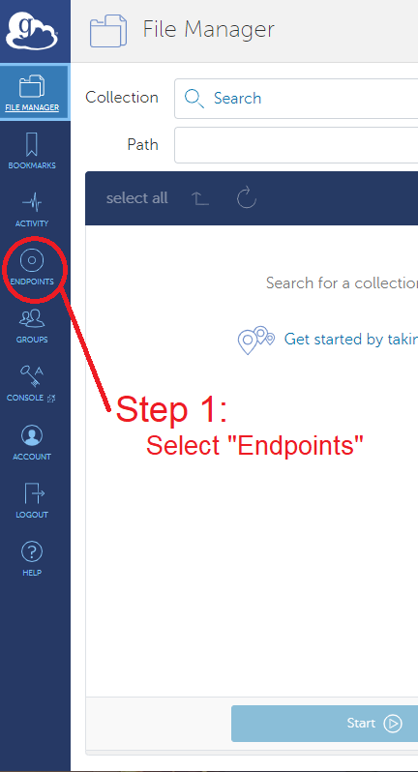
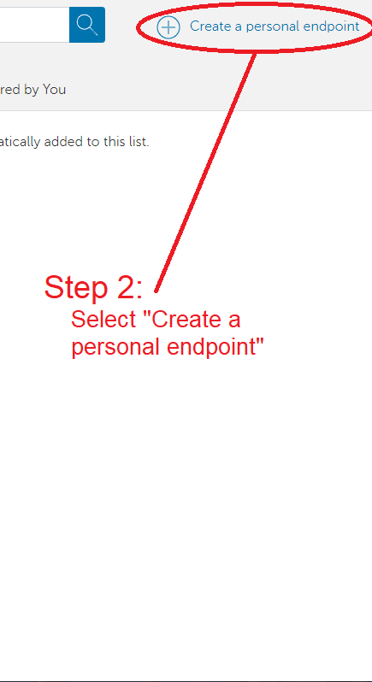
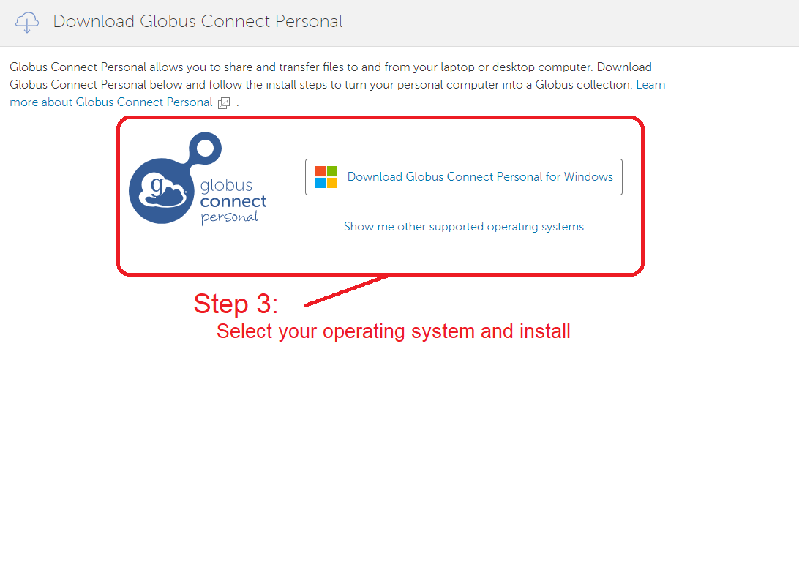

Slide 11
Globus Demo (2)
Transferring Files can be done through the GUI
From the File Manager tab:
Click the “Two Panel” view button at the top right.
Click the top left Search bar.
Search “CU Boulder Research Computing” and select the end point.
Sign into Research Computing’s Endpoint
Click the right search bar
On the ‘Your Collections’ tab, choose the endpoint you created
Transfer your files!

Slide 12
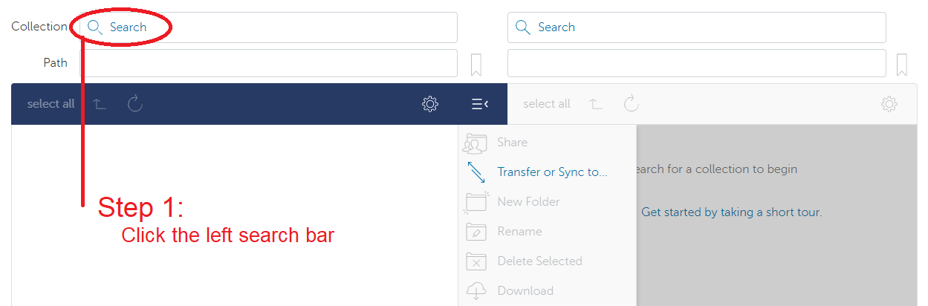
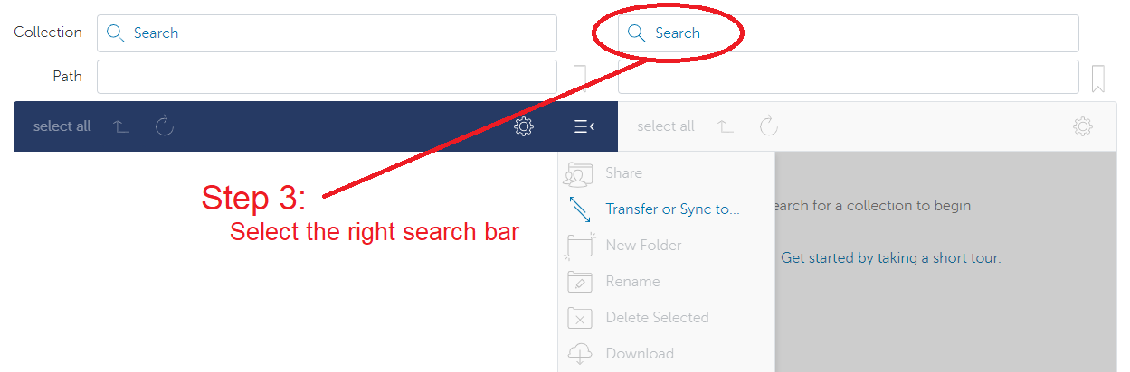
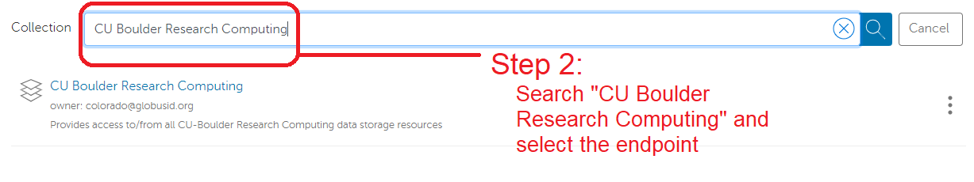
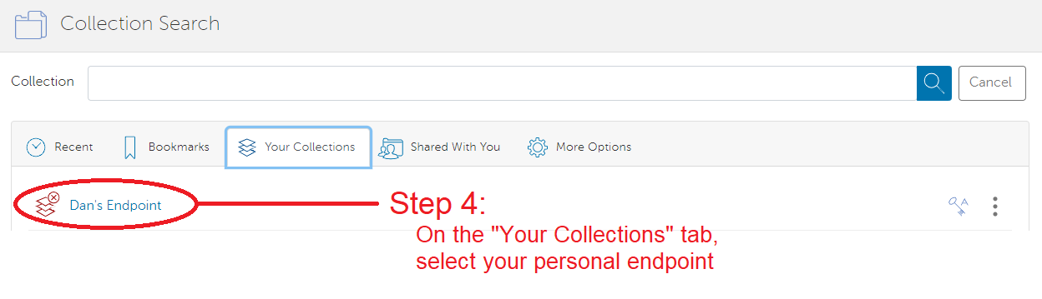

Slide 13
More on Data transfers
sshfs
Mounting the RC filesystem to your drive remotely!
Single sign in for multiple data transfers
Great when needing to repeatedly access files on RC Resources
rsync/rclone
Another utility to transfer files
Particularly useful in repeated file transfers and synchronization of file sets
Snapshot like backups
https://github.com/ResearchComputing/Documentation/blob/dev/docs/compute/rclone.md

Slide 14
Sharing Data
Other RC Users
To share a Petalibrary space with other RC users. Simply contact RC with a list of users you would wish to allow access.
RC will place the chosen users in the owner’s group
The owner can then set up permissions in the space
On premise collaborators can also access Petalibrary files with Globus Shared Endpoints
Off-premise collaborators
Off premise collaborators can only access Petalibrary files through Globus Shared Endpoints

Slide 15
Globus Shared Endpoints
Globus offers ‘shared endpoints’ which don’t require a user to have an account with RC.
RC provides this capability for easy access of Data.
Generates a shared collection that can be accessed with a link.
Can assign various permissions to specific users or all users withing Globus
More information on here: https://docs.globus.org/how-to/share-files/

Slide 16
Data Publishing with Petalibrary
Using Globus shared endpoints can be a great way to publish your data while maintaining the convenience of having it Petalibrary.
Example: https://scholar.colorado.edu/concern/datasets/9593tw13k

Slide 17
Computing with Data on Petalibrary
Petalibrary Active allocations are available for active compute
Blanca
Lacks supported performant scratch space for compute
Petalibrary Active is parallel I/O capable
Petalibrary can be used as a location to have performant I/O
Summit
Has a dedicated performant scratch space for compute
Petalibrary has comparable performance with Scratch
Permanent location

Slide 18
Checking your Petalibrary Allocation
curc-quota – Research Computing tool to monitor disk usage.
Provides detailed summary of your core storage
Provides detailed summary of scratch space on compile and compute nodes
Also lists current capacity of all Petalibrary allocations you have access to
[userXXXX@login12 ~]$ curc-quota

Slide 19
Getting a Petalibrary Allocation
Any user affiliated with Research Computing and CU Boulder has access to Purchase a Petalibrary allocation
Contact us at: rc-help@colorado.edu to get started!
Petalibrary MOU
Core Facilities receive their first x.TB free for their first year
Storage Solution | FY20 Service Fees
Active Storage | $45/TB/year
Active w/ Archive Copy | $55/TB/year
Archive Storage | $20/TB/year

Slide 20
Thank you!
Please fill out the survey: http://tinyurl.com/curc-survey18
Sign in! http://tinyurl.com/curc-names
Contact information: rc-help@Colorado.edu
Slides: https://github.com/ResearchComputing/Petalibrary_Spring_2021

